Slide 1
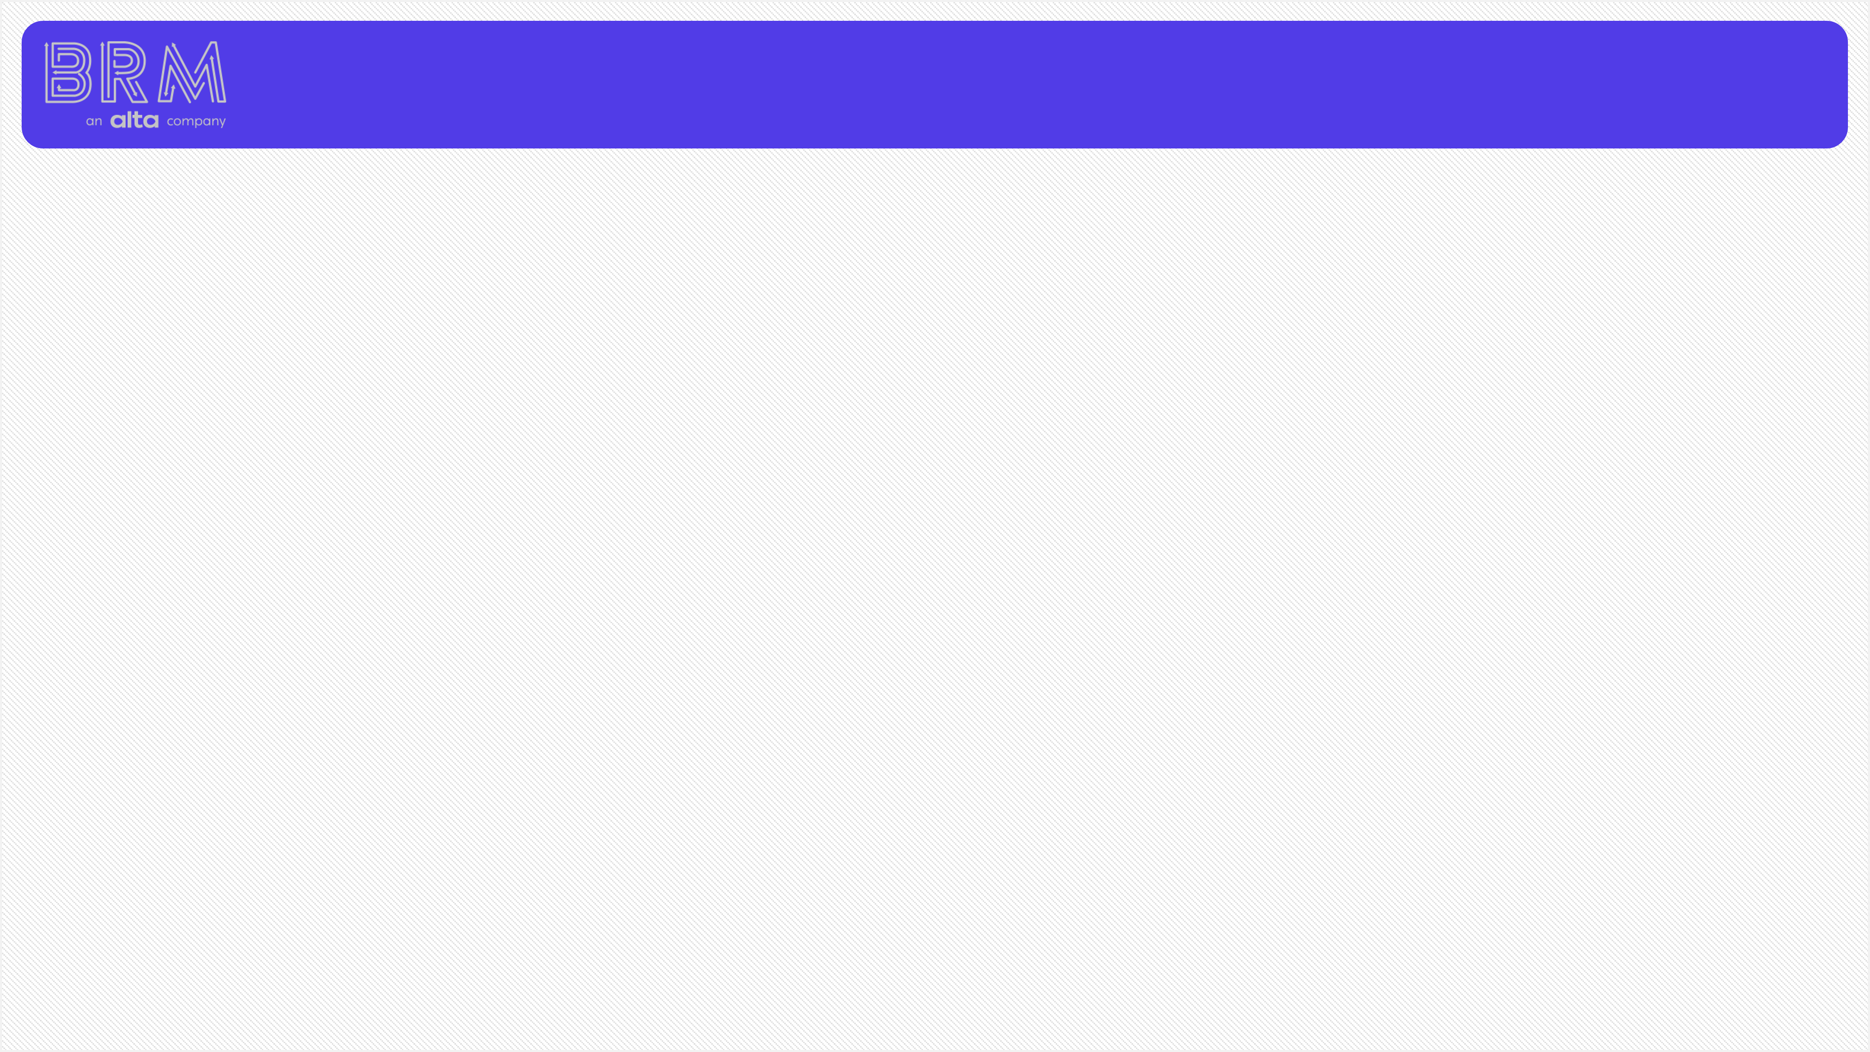
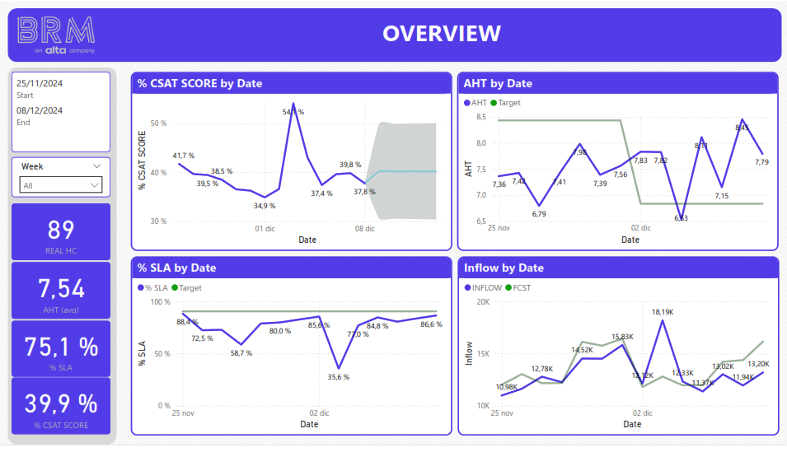
TEST RESULTS REPORT
CUSTOMER SERVICE AND PERFORMANCE ANALYSIS
The data was extracted, cleaned, and transformed for the following analysis. The dashboard shows that the CSAT score during 15 days is 39.9% for this line of business and is actually lower than expected, at least we are analyzing a LOB dedicated to safety. A good CSAT (customer satisfaction) score is above 75%, which means a great opportunity for improvement.
On the other hand, the SLA (Service Level Agreement) is about 75.1%, lower than the predicted value or a known target. A healthy SLA is equal to or greater than 90.0%, in which case the trend line is below the target.
The Average Handle Time, or AHT, has been under control until December 3, with a cyclical increase over time, as the target has been reduced since December 3. The current value is 7.54 minutes.
The trend of the inflow has been adjusted in comparison with the forecast, which means that the planning of the resources could be perfectly adjusted.

Slide 2
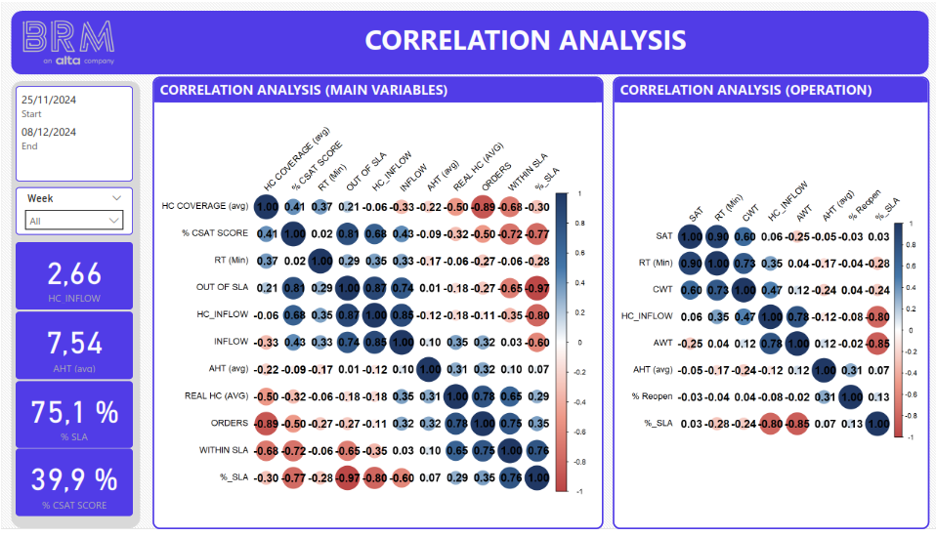
TEST RESULTS REPORT
CUSTOMER SERVICE AND PERFORMANCE ANALYSIS
The correlation analysis reveals which variables are affecting the clients' perception (CSAT) and the operational variables such as SLA and AHT.
It is clear from the evaluation of the impacts on the CSAT score that cases solved OUT of SLA have a positive influence on the CSAT score during the 15 days, and that the number of orders and the %SLA have an inverse influence. An increase in orders and a decrease in CSAT is to be expected due to volume handling. However, the SLA is crucial for ensuring a positive perception, so it is likely that the issues are not. This behavior could be influenced by cases where agents need more time to effectively solve the case. Other possible reasons include user-facing obstacles such as documentation issues and rejections. It is crucial to examine the significance of time. The ratio of inflow to HC positively impacts the CSAT score, indicating that the more cases an agent handles, the more significant their impact on results.

Slide 3
TEST RESULTS REPORT
CUSTOMER SERVICE AND PERFORMANCE ANALYSIS
The SLA shows clear evidence of an inverse impact from the ratio inflow/HC and the AWT (Average Waiting Time). This suggests that as the agents solve more cases, they are taking even more time than expected, which is matching with the AWT. To improve the SLA, we must address these issues, especially the AWT.
On the other hand, the AHT has no obvious reason for the progressive increase, and is barely affected by the CWT and the number of HC and their coverage. Correlation does not always mean causation.

Slide 4
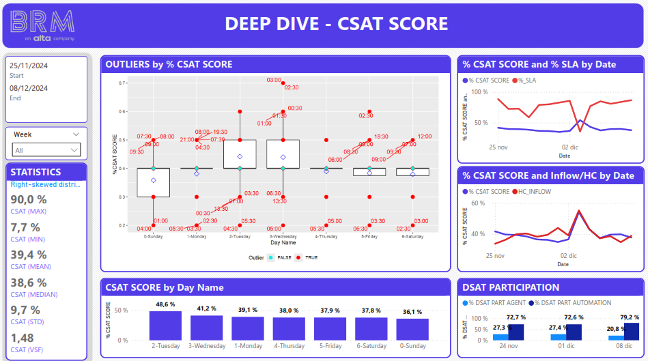
TEST RESULTS REPORT
CUSTOMER SERVICE AND PERFORMANCE ANALYSIS
A deeper look at the CSAT score reveals a mean of 39.4%, with significant variation. Boxplots organised by day show clear dispersion of data on Sundays, Tuesdays and Wednesdays, especially on Sundays, with outliers in the night shifts. The weekend is when we see the lowest scores, so we know we need more supervision and coaching.
The trendlines confirm the impact of the SLA and Inflow/HC on the CSAT score. In my experience, an inverse influence of the SLA means quicker but inefficient resolutions, even stoppers.
Finally, the proportion of DSATs is more influenced by partially automated resolutions. Participation is over 70%, so we need to look more closely at those processes.
Pain points: Weekends, night shifts and inefficient automated processes. The automated resolutions are clearly a reason for low CSATs and higher SLAs.

Slide 5
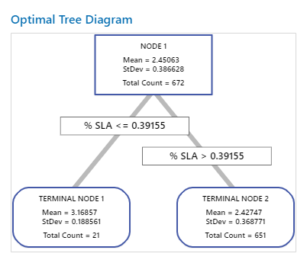
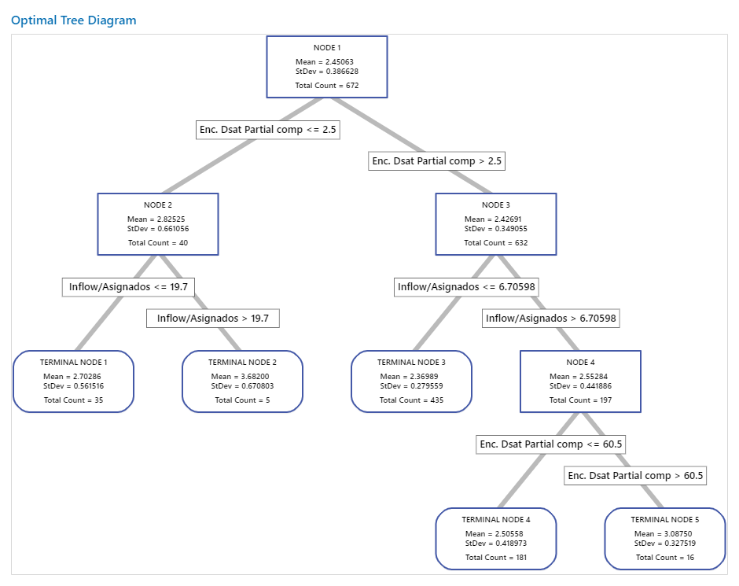
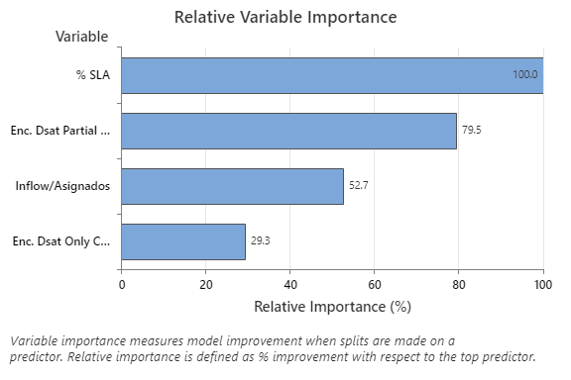
TEST RESULTS REPORT
CUSTOMER SERVICE AND PERFORMANCE ANALYSIS
Applying a decision tree model (by regression), we first find that the CSAT rating does indeed generate an inverse influence, which is atypical since the SLA theoretically ensures a timely response to the user. The highest average CSAT is for an SLA below 39.15%, which is well below the target (90.0%). On the other hand, it is evident that the DSATs received by partially automated treatment directly affect the CSAT rating, since when more than 2.5 surveys are received related to this means, the CSAT rating is lower and according to the sample, they represent 94.0% of the total cases. This result invites the development of improvement projects for this type of care.
Currently, the classification model is weak to make further resolutions due to the amount of data available, but the trend is clear. To develop predictive models and tune the variables to obtain good results, a greater amount of data is required, since not all cases have the same nature and should be analyzed according to the issue classification or resolution paths.

Slide 6
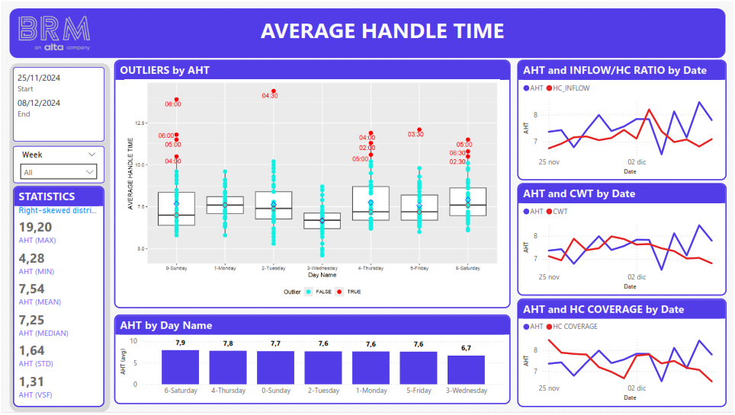
TEST RESULTS REPORT
CUSTOMER SERVICE AND PERFORMANCE ANALYSIS
The AHT has a mean of 7.54 minutes and has been above the target since December 12th. The trends of the ratio of inflow/HC, CWT and coverage have been decreasing since December 3, causing fluctuations in the AHT. The lower the coverage and presence of agents, the more time is spent on interaction, suggesting new hires.
On the other hand, the outliers are concentrated in the night shifts and early mornings.
It is important to evaluate the tenure of the agents, on Wednesdays the AHT is below 7.0 minutes and has the lowest data dispersion, suggesting more tenure or even top performers. Couching is an important key.

Slide 7
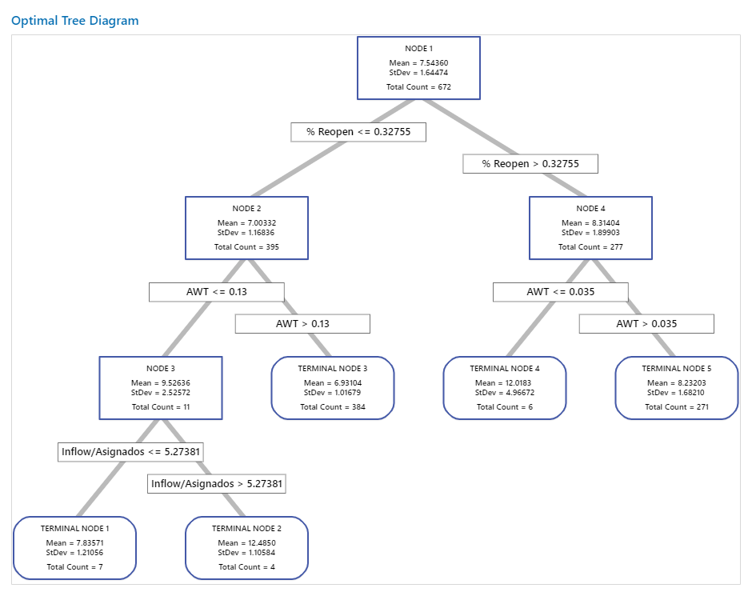
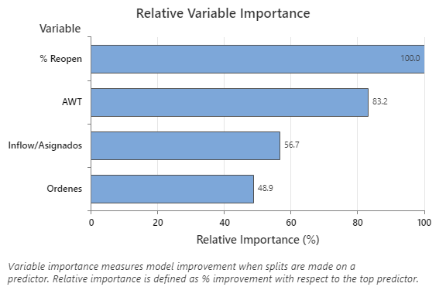
TEST RESULTS REPORT
CUSTOMER SERVICE AND PERFORMANCE ANALYSIS
The classification model indicates that for AHT, the strongest variables to rank are %Reopen and AWT. In the case of %Reopen, when the ratio is above 32.75%, the average AHT tends to be 8.31 ± 1.89 minutes, while when this ratio is below, the average AHT tends to be 7.0 ± 1.86 minutes, which is favorable. It is important to note that a healthy %Reopen is equal to or less than 30.0%. On the other hand, high inflow/outflow ratios are unfavorable for AHT, which may be a sign of overload.
Currently, the classification model is weak to make further resolutions due to the amount of data available, but the trend is clear. To develop predictive models and tune the variables to obtain good results, a greater amount of data is required, since not all cases have the same nature and should be analyzed according to the issue classification or resolution paths.

Slide 8
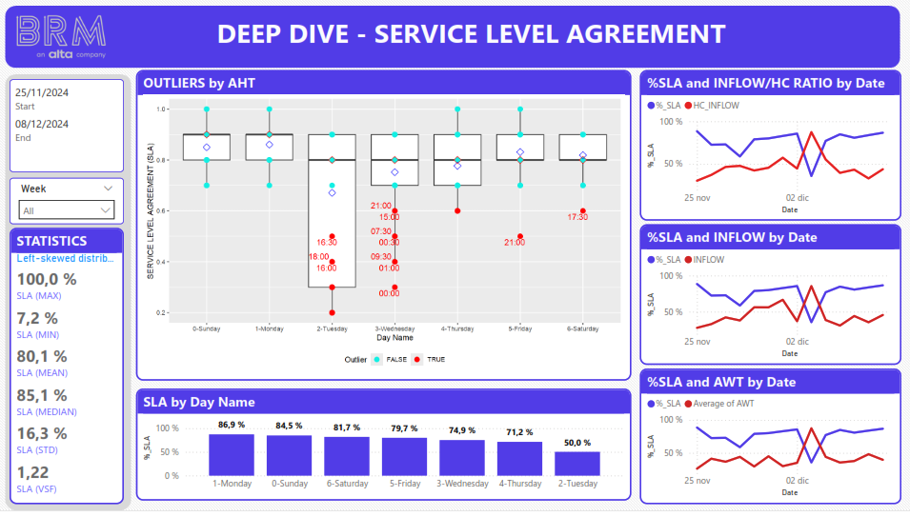
TEST RESULTS REPORT
CUSTOMER SERVICE AND PERFORMANCE ANALYSIS
The SLA was presented and increased since the atypical behavior in December 3. To increase the SLA it is important to keep the AWT low, the influence is significant (85%). The lowest SLA is on Tuesdays and it is important to keep mentoring, on Tuesdays not only have the lowest SLA, the most dispersive operation in terms of SLA. The average is 80.1%, with a serious opportunity for improvement.
On the other hand, it is necessary to evaluate if the proportion of SLA is due to automated processes, generating false expectations.
Dec 3

Slide 9
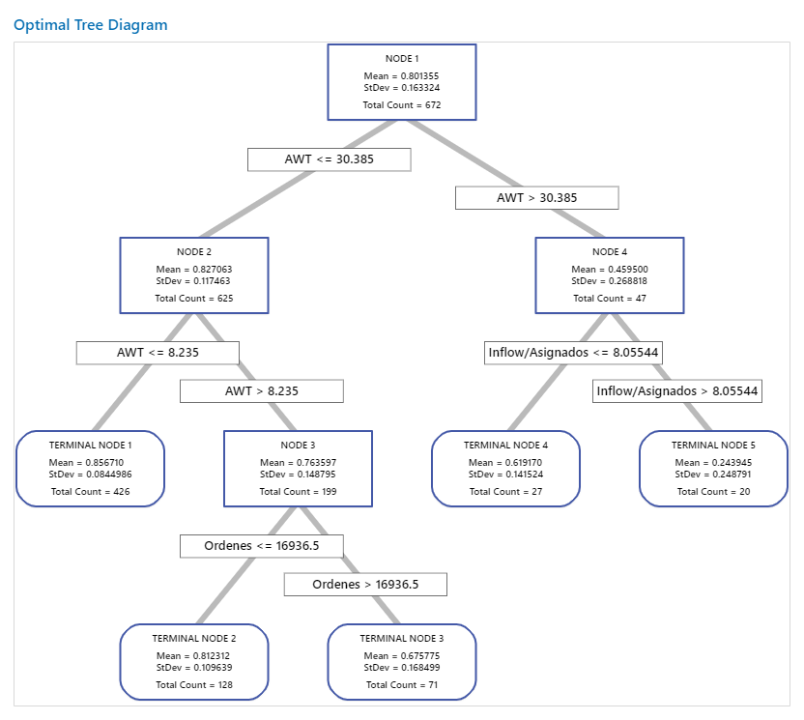
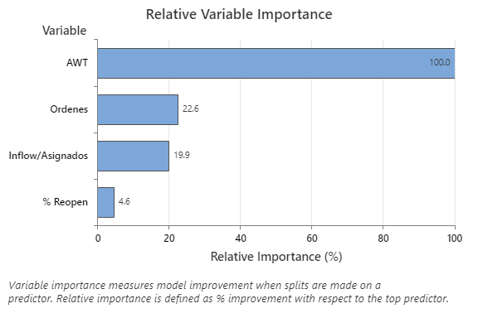
TEST RESULTS REPORT
CUSTOMER SERVICE AND PERFORMANCE ANALYSIS
As for the SLA, the classification model shows that the variable that most influences the classification is the AWT. An AWT greater than 30.4 minutes presents an average SLA of 46.0%, representing 7% of the cases in the sample, while for AWT values less than 30.4 minutes, the average SLA tends to be 82.7%, representing 93% of the evaluated data. The best scenario is an AWT equal to or less than 8.2 minutes, achieving an average SLA of 85.7% ± 8.4%. Considering a tree with the best R2 value, the best scenario is found in cases whose AWT is less than 2.9 minutes, resulting in an average SLA of 88.6% ± 5.9%, representing 29.8% of the evaluated data, being the closest value to the target.
As with the other models, it is important to keep in mind that the amount of data is not sufficient to provide a more accurate result, but it shows a trend that is consistent with what is observed in the trends. It is also important to keep in mind that general values are being evaluated and each case is of a different nature, so more data is needed to compare, as they say colloquially, pears with pears and not pears with apples.

Slide 10
TEST RESULTS REPORT
CUSTOMER SERVICE AND PERFORMANCE ANALYSIS
NEXT STEPS:
To establish data ranges with secure performance, build an Xgboost model or a Random Forest model to accurately predict the impact of key variables. This step requires a good set of data considering continuous and categorical data. Both for training and testing.
Develop a sentiment analysis model to know the VOCs and thus be able to give users a more accurate answer to what they are looking for.
Develop time series models to better estimate where the operation is going and set clear goals. Glide paths are not a good idea if you don't know where you're going from where you are.
Network analysis is useful to know which processes are creating bottlenecks or unnecessary steps to solve the cases.
Develop, mentoring activities on a regular basis, especially on days prior to those days that shoe patterns of lost of performance.

